Slide 1
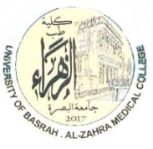

University of Basrah Al-zahraa medical college
Ministry of higher Education and Scientific Researches
The module: Mechanism of Disease
Haemostasis and Thrombosis (I)
Module staff: Session 5
Dr. Ihsan Mardan
Dr. Sadiq K. Ali
Dr. Ghada Lateef
Dr. Wasan Mansur
Dr. Iman Abdul-Hadi
Dr. Safa Asaad
Robbin’s Basic pathology 9th edition
Hoffbrands Essential Haematology 7th edition

Slide 2
University of Basrah Al-zahraa medical college
Ministry of higher Education and Scientific Researches
Learning objectives:
Haemostasis;
  Definition
  Balance of coagulant and anticoagulant factors
  Intrinsic and extrinsic pathways
  Role of platelets
  Fibrinolytic system
Thrombosis;
  Definition
  Predisposing factors
  Effects of thrombosis
  Outcomes

Slide 3
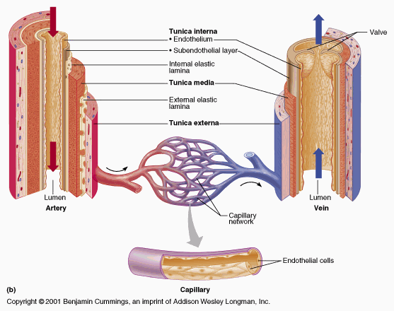


Slide 4
The health of cells and tissues depends on an intact circulation to deliver oxygen and remove wastes and on normal fluid homeostasis.
normal fluid homeostasis means maintaining blood as a liquid until clot formation is mandatory.

Slide 5
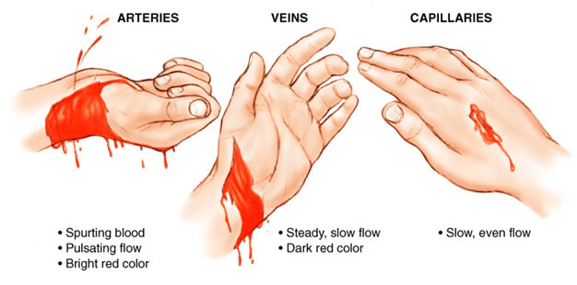
1- HAEMOSTASIS
Why don’t you bleed to death from a minor injury?

Slide 6
1- HAEMOSTASIS
Haemostasis refers more widely to the process whereby blood coagulation is initiated and terminated in a tightly regulated fashion, together with the removal (or fibrinolysis) of the clot as part of vascular remodelling.
Global process by which vascular integrity and patency are maintained over the whole organism, for its lifetime.
Normal haemostasis comprises a series of regulated processes that maintain blood in a fluid, clot-free state in normal vessels while rapidly forming a localized haemostatic plug at the site of vascular injury.

Slide 7
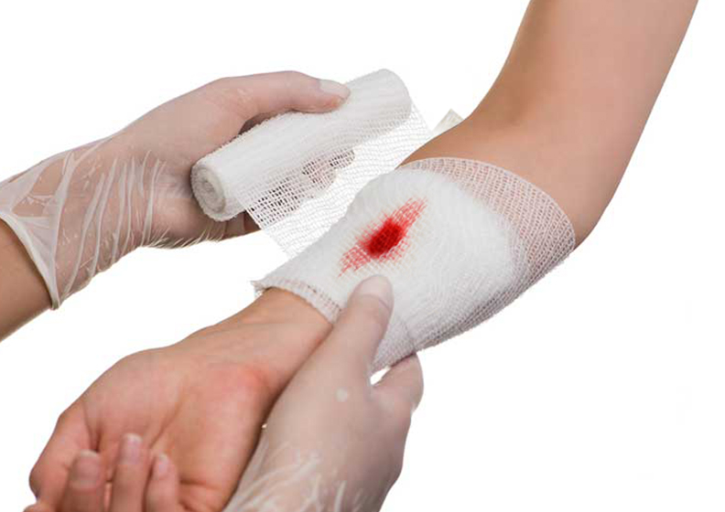
1- HAEMOSTASIS

Slide 8
HAEMOSTASIS
The haemostatic mechanisms have several important functions:
(1) to maintain blood in a fluid state while it remains circulating within the vascular system;
(2) to arrest bleeding at the site of injury or blood loss by formation of a haemostatic plug;
(3) to limit this process to the vicinity of the damage and
(4) to ensure the eventual removal of the plug whilst healing is completed

Slide 9
HAEMOSTASIS
There are at least five different components involved:
blood vessels,
platelets,
plasma coagulation factors and
their inhibitors and
the fibrinolytic system.
Deficiency or exaggeration of any one may lead to either thrombosis or haemorrhage

Slide 10
ENDOTHELIUM
Central regulators of haemostasis
The balance between the antithrombotic and prothrombotic activities of endothelium determines whether thrombus formation, propagation, or dissolution occurs.
At baseline, endothelial cells exhibit antithrombotic (antiplatelet, anticoagulant, and fibrinolytic properties), however, they are capable (after injury or activation) of exhibiting numerous procoagulant activities.

Slide 11
Antithrombotic Properties (Endothelium)
Antiplatelet Effects
An intact endothelium prevents platelets (and plasma coagulation factors) from interacting with the highly thrombogenic subendothelial extracellular matrix (ECM).
Prostacyclin (PGI₂) and nitric oxide (NO).
Adenosine diphosphatase.
Anticoagulant Effects
Heparin-like molecules, thrombomodulin and tissue factor pathway inhibitor
Fibrinolytic Effects
Plasminogen activator (t-PA)

Slide 12
Prothrombotic Properties (Endothelium)
Platelet effects: Endothelial injury brings platelets into contact with the subendothelial ECM, which includes among its constituents von Willebrand factor (vWF)
Procoagulant effects. In response to cytokines (e.g., tumour necrosis factor [TNF] or interleukin-1 [IL-1]) or certain bacterial products including endotoxin, endothelial cells produce tissue factor, the major in vivo activator of coagulation, and downregulate the expression of thrombomodulin.
Antifibrinolytic effects. Endothelial cells also secrete inhibitors of plasminogen activator (PAIs)

Slide 15
Endothelial Cells and Coagulation (summary)
• Intact, normal endothelial cells help to maintain blood flow by inhibiting the activation of platelets and coagulation factors.
• Endothelial cells stimulated by injury or inflammatory cytokines upregulate expression of procoagulant factors (e.g., tissue factor) that promote clotting, and downregulate expression of anticoagulant factors.
• Loss of endothelial integrity exposes subendothelial vWF and basement membrane collagen, stimulating platelet adhesion, platelet activation, and clot formation.

Slide 16
PLATELETS
Platelets play a critical role in normal haemostasis by forming a haemostatic plug that seals vascular defects, and by providing a surface that recruits and concentrates activated coagulation factors.
Normal platelet count is 150-400 x 10⁹/L.
After vascular injury, platelets encounter ECM constituents (collagen is most important) and adhesive glycoproteins such as vWF.

Slide 17
This sets in motion a series of events that lead to;
Platelet adhesion,
Platelet activation, and
Platelet aggregation.
Platelet Adhesion
Platelet adhesion initiates clot formation.
Adhesion to ECM is mediated largely via interactions with vWF that acting as a bridge between platelet surface receptors (e.g., GpIb) and exposed collagen.

Slide 18
Platelet Activation
Secretion of both granule types (α granules and δ granules) occurs soon after adhesion.
The subtle membrane changes include an increase in the surface expression of negatively charged phospholipids, which provide binding sites for both calcium and coagulation factors, and a conformation change in platelet GpIIb/IIIa that permits it to bind fibrinogen.

Slide 19
Platelet Aggregation
Aggregation follows platelet adhesion and granule release. In addition to ADP, platelet-synthesized thromboxane A₂ which is an important stimulus for platelet aggregation.
Aggregation is promoted by bridging interactions between fibrinogen and GpIIb/IIIa receptors on adjacent platelets.
ADP and TXA₂ promotes formation of an enlarging platelet aggregate, the primary haemostatic plug.

Slide 20
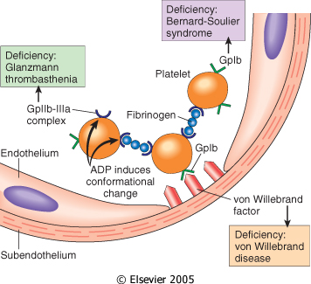

Slide 21
This primary aggregation is reversible. However, with activation of the coagulation cascade, the generation of thrombin results in two processes that make an irreversible haemostatic plug.
Thrombin binds to a platelet surface receptor (protease-activated receptor, or PAR); in association with ADP and TXA₂, this interaction induces further platelet aggregation. Platelet contraction follows, creating an irreversibly fused mass of platelets constituting the definitive secondary haemostatic plug.
Concurrently, thrombin converts fibrinogen to fibrin within and about the platelet plug, contributing to the overall stability of the clot.

Slide 22
Platelet Adhesion, Activation, and Aggregation (summary)
• Endothelial injury exposes the underlying basement membrane ECM; platelets adhere to the ECM primarily through binding of platelet GpIb receptors to vWF.
• Adhesion leads to platelet activation, an event associated with secretion of platelet granule contents, including calcium and ADP, dramatic changes in shape and membrane composition; and activation of GpIIb/IIIa receptors.
• The GpIIb/IIIa receptors on activated platelets form bridging crosslinks with fibrinogen, leading to platelet aggregation.
• Concomitant activation of thrombin promotes fibrin deposition, cementing the platelet plug in place.

Slide 23
COAGULATION CACGADE
The coagulation cascade is a successive series of amplifying enzymatic reactions. At each step in the process, a proenzyme is proteolyzed to become an active enzyme, which in turn proteolyzes the next proenzyme in the series, eventually leading to the activation of thrombin and the formation of fibrin.
These components typically are assembled on a phospholipid surface and are held together by interactions that depend on calcium ions.

Slide 24
Once activated, the coagulation cascade must be tightly restricted to the site of injury to prevent inappropriate and potentially dangerous clotting elsewhere in the vascular tree.
In addition to the restriction of factor activation to sites of exposed phospholipids, three categories of natural anticoagulants function to control clotting:
antithrombins,
proteins C and S, and
tissue factor pathway inhibitor (TFPI).

Slide 25
Antithrombins (e.g., antithrombin III) inhibit the activity of thrombin and other serine proteases, factors IXa, Xa, XIa, and XIIa.
Proteins C and S are two vitamin K-dependent proteins that inactivate the cofactors Va and VIIIa.
Tissue factor pathway inhibitor (TFPI) is a protein secreted by endothelium (and other cell types) that inactivates factor Xa and tissue factor–factor VIIa complexes

Slide 27
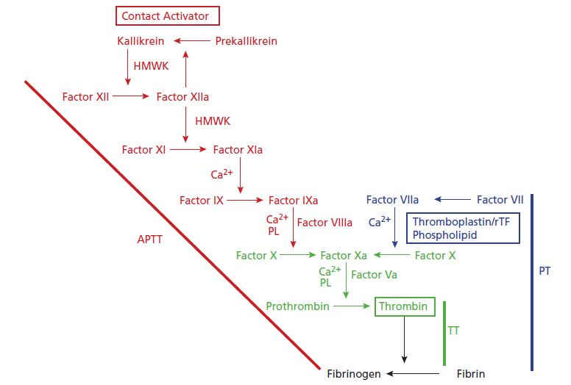
The coagulation cascade. The traditional concept of blood coagulation with separate intrinsic (red) and extrinsic (blue) pathways converging on the common pathway (green) with the generation of FXa.

Slide 28
FIBRINOLYTIC SYSTEM
Fibrinolysis is largely carried out by plasmin, which breaks down fibrin and interferes with its polymerization
The resulting fibrin split products (FSPs or fibrin degradation products). Elevated levels of FSPs (most notably fibrin-derived D-dimers) can be used for diagnosing abnormal thrombotic states including disseminated intravascular coagulation (DIC), deep venous thrombosis, or pulmonary thromboembolism.

Slide 29
Plasmin is generated by proteolysis of plasminogen, an inactive plasma precursor, either by factor XII or by plasminogen activators:
Tissue-type plasminogen activator (t-PA) is the most important of the plasminogen activators.
Urokinase-like plasminogen activator (u-PA) is another plasminogen activator present in plasma and in various tissues; it can activate plasmin in the fluid phase.
Streptokinase, is bacterial product which is used clinically to lyse clots in some forms of thrombotic disease.

Slide 30
To prevent excess plasmin from lysing thrombi indiscriminately throughout the body, free plasmin rapidly complexes with circulating α2-antiplasmin and is inactivated.
Endothelial cells further modulate the coagulation– anticoagulation balance by releasing plasminogen activator inhibitors (PAIs)
{PAIs increased by inflammatory cytokines that’s why thrombosis occurs in severe inflammation}.

Slide 31
Fibrinolytic system

Slide 32
Coagulation Factors (summary)
• Coagulation occurs via the sequential enzymatic conversion of a cascade of circulating and locally synthesized proteins.
• Tissue factor elaborated at sites of injury is the most important initiator of the coagulation cascade in vivo.
• At the final stage of coagulation, thrombin converts fibrinogen into insoluble fibrin that contributes to formation of the definitive haemostatic plug.

Slide 33
Coagulation Factors (summary)
• Coagulation normally is restricted to sites of vascular injury by:
  limiting enzymatic activation to phospholipid surfaces provided by activated platelets or endothelium.
  natural anticoagulants elaborated at sites of endothelial injury or during activation of the coagulation cascade.
  expression of thrombomodulin on normal endothelial cells, which binds thrombin and converts it into an anticoagulant.
  activation of fibrinolytic pathways (e.g., by association of tissue plasminogen activator with fibrin)
  • The coagulation assay can be assessed by PT, APTT and INR.

Slide 34
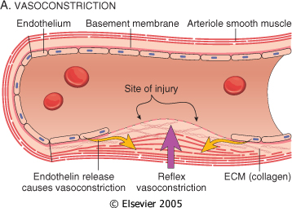

Slide 35
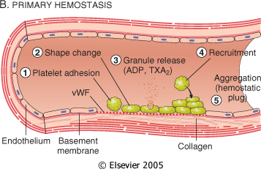

Slide 36
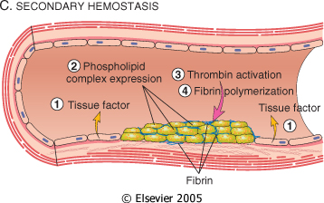

Slide 37
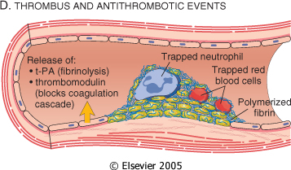

Slide 38
2- THROMBOSIS
The pathologic counterpart of haemostasis is thrombosis, the formation of blood clot (thrombus) within intact vessels.
The three primary abnormalities that lead to thrombus formation (Virchow’s triad):
(1) endothelial injury,
(2) stasis or turbulence of blood flow, and
(3) blood hypercoagulability

Slide 39
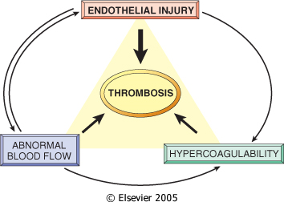

Slide 40
Endothelial Injury
Endothelial injury is an important cause of thrombosis, particularly in the heart and the arteries (e.g., thrombi in the cardiac chambers after myocardial infarction)
Dysfunctional endothelium (hypertension) elaborates greater amounts of procoagulant factors (e.g., platelet adhesion molecules, tissue factor, PAI) and synthesizes lesser amounts of anticoagulant molecules (e.g., thrombomodulin, PGI₂, t-PA).

Slide 41
Alterations in Normal Blood Flow
Turbulence contributes to arterial and cardiac thrombosis by causing endothelial injury or dysfunction, as well as by forming countercurrents and local pockets of stasis; stasis is a major contributor to the development of venous thrombi.
Hyperviscosity syndromes (such as polycythemia) increase resistance to flow and cause small vessel stasis; the deformed red cells in sickle cell anemia cause vascular occlusions, and the resultant stasis also predisposes to thrombosis.

Slide 42
Hypercoagulability
Hypercoagulability contributes infrequently to arterial or intracardiac thrombosis but is an important underlying risk factor for venous thrombosis.
It is loosely defined as any alteration of the coagulation pathways that predisposes to thrombosis, and it can be divided into primary (genetic) and secondary (acquired) disorders:

Slide 44
Morphology
Thrombi can develop anywhere in the cardiovascular system (e.g., in cardiac chambers, on valves, or in arteries, veins, or capillaries). The size and shape of a thrombus depend on the site of origin and the cause
Arterial or cardiac thrombi typically arise at sites of endothelial injury or turbulence; venous thrombi characteristically occur at sites of stasis.
Thrombi are focally attached to the underlying vascular surface and tend to propagate toward the heart; thus, arterial thrombi grow in a retrograde direction , while venous thrombi extend in the direction of blood flow.

Slide 45
The propagating portion of a thrombus tends to be poorly attached and therefore prone to fragmentation and migration through the blood as an embolus.
Thrombi can have grossly (and microscopically) apparent laminations called lines of Zahn; these represent pale platelet and fibrin layers alternating with darker red cell–rich layers. Such lines are significant in that they are only found in thrombi that form in flowing blood.
Their presence can therefore usually distinguish antemortem thrombosis from the nonlaminated clots that form in the postmortem state.

Slide 46
Arterial thrombi are typically relatively rich in platelets, as the processes underlying their development (e.g., endothelial injury) lead to platelet activation.
Venous thrombi (phlebothrombosis) frequently propagate some distance toward the heart that is prone to give rise to emboli.
Venous thrombosis is largely the result of activation of the coagulation cascade, and platelets play a secondary role. Because these thrombi form in the sluggish venous circulation, they tend to contain more enmeshed red cells, leading to the red, or stasis, thrombi. The veins of the lower extremities are most commonly affected (90% of venous thromboses).
Thrombi on heart valves are called vegetations.

Slide 47
Fate of the Thrombus
Propagation.
Embolization..
Dissolution.
Organization and recanalization.

Slide 48
Fate of the Thrombus
Propagation: The thrombus enlarges through the accretion of additional platelets and fibrin.
Embolization: Part or all of the thrombus is dislodged and transported elsewhere in the vasculature.
Dissolution: If a thrombus is newly formed, activation of fibrinolytic factors may lead to its rapid shrinkage and complete dissolution.

Slide 49
Fate of the Thrombus
With older thrombi, extensive fibrin polymerization renders the thrombus substantially more resistant to plasmin-induced proteolysis, and lysis is ineffectual.
Therapeutic administration of fibrinolytic agents is not effective unless given within a few hours of thrombus formation.
Organization and recanalization: Older thrombi become organized by the ingrowth of endothelial cells, smooth muscle cells, and fibroblasts into the fibrin-rich thrombus.

Slide 50
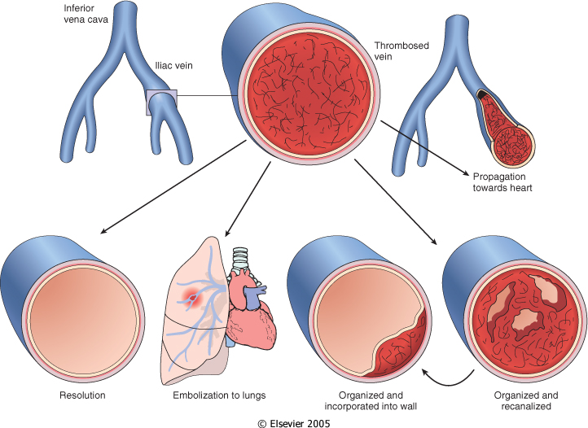

Slide 51
Thrombosis (summary)
• Thrombus development usually is related to one or more
components of Virchow’s triad:
endothelial injury (e.g., by toxins, hypertension, inflammation, or metabolic products)
abnormal blood flow, stasis or turbulence (e.g., due to aneurysms, atherosclerotic plaque)
hypercoagulability: either primary (e.g., factor V Leiden, increased prothrombin synthesis, antithrombin III deficiency) or secondary (e.g., prolonged bed rest, tissue damage, malignancy)
• Thrombi may propagate, resolve, become organized, or
embolize.
• Thrombosis causes tissue injury by local vascular occlusion or by distal embolization.

Slide 52


